Slide 1
Course Code: IT 22
Software Project Management

Slide 2
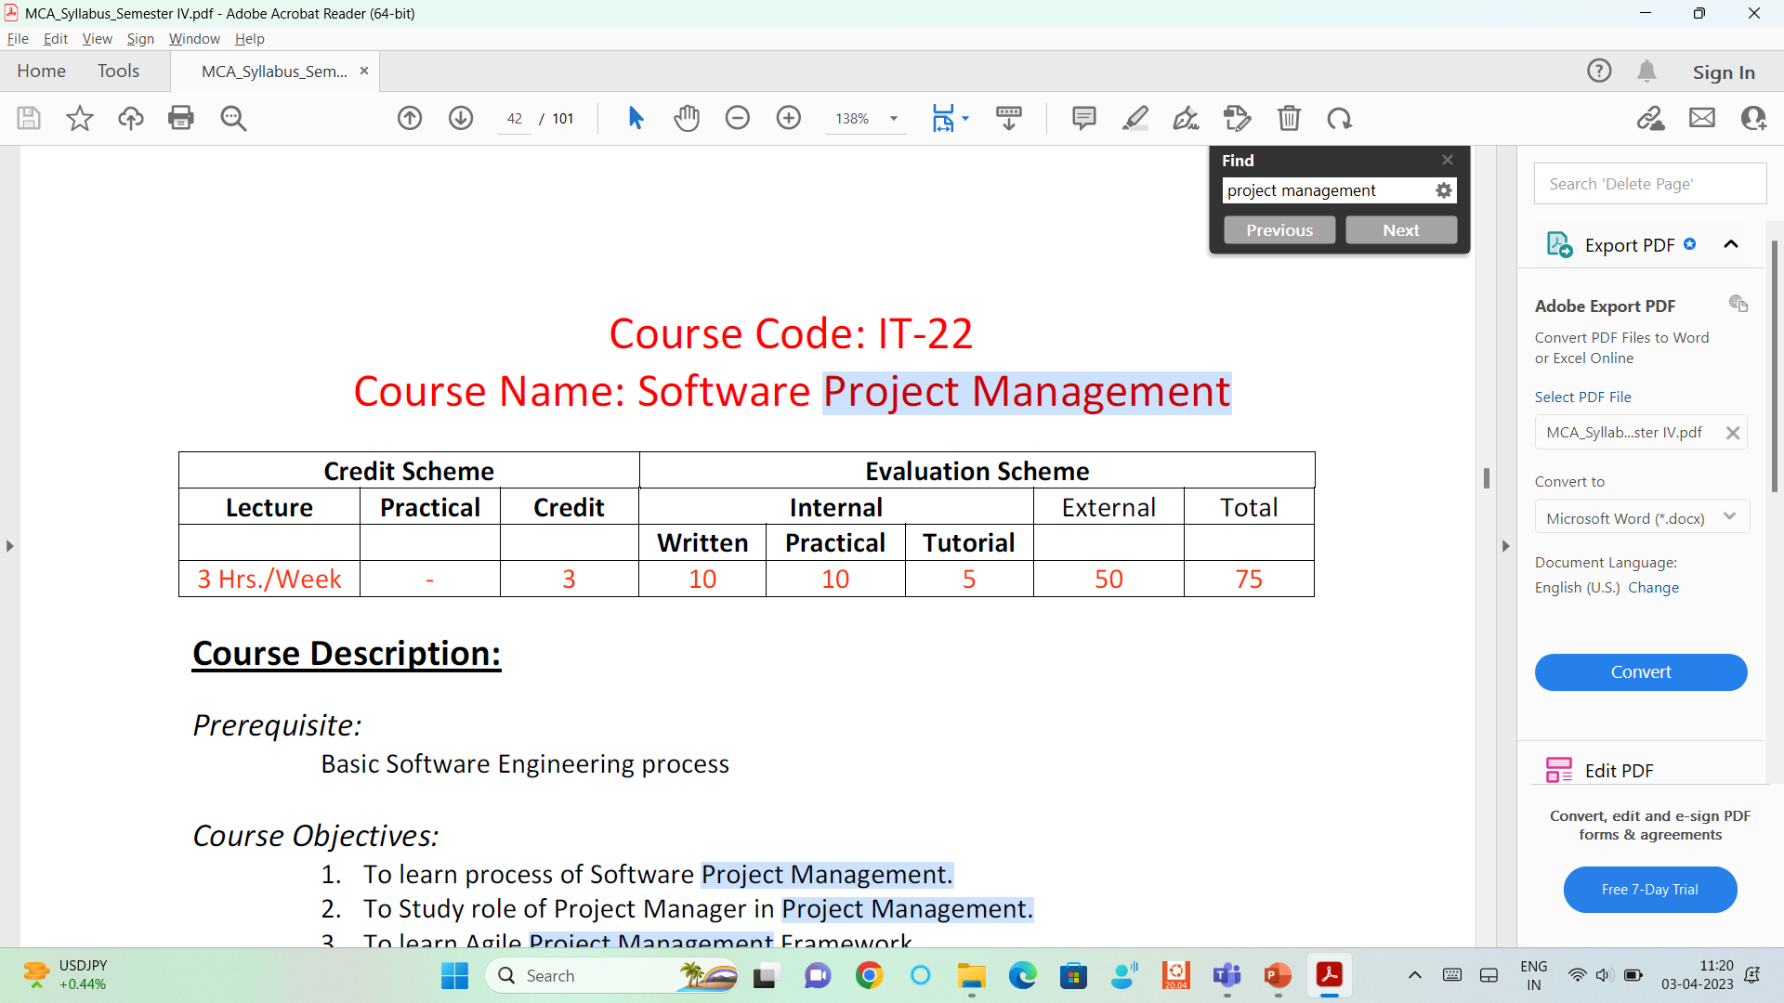
Marks Distribution:

Slide 3
Course Objectives:
1. To learn process of Software Project Management.
2. To Study role of Project Manager in Project Management.
3. To learn Agile Project Management Framework.
4. To study various role of Agile Team and Tools.
5. To understand project planning and tracking.

Slide 4
Topics to be covered:
Linear Project Management Framework
Linear Software Project Estimation
Agile Project Management Framework (Sprint planning - three coding tasks, two testing tasks, and one documentation , Advantages, Disadvantage)
Agile Teams, Size and Schedule
Tracking Agile Project and Reports
Implementation with Agile Tools

Slide 5
01
Overview of Project Management
02
Project Management Life Cycle
03
Project Management Process
Topics
04
Role of Project Manager
05
Project Management Process

Slide 6



01
OVERVIEW OF PROJECT MANAGEMENT
What is Project:

Slide 7
01
OVERVIEW OF PROJECT MANAGEMENT
Project management is the process of coordinating a team and its resources to successfully execute a specific task from start to finish.
It includes planning the activities, measuring the progress, allocating resources, identifying constraints and completing the task.

Slide 8
02
PROJECT MANAGEMENT LIFE CYCLE-
The Project Management Life Cycle is a set of tasks that must be completed in order for a project's goals or targets to be met.
It's a structure that outlines the steps involved in turning an idea into a reality.

Slide 9
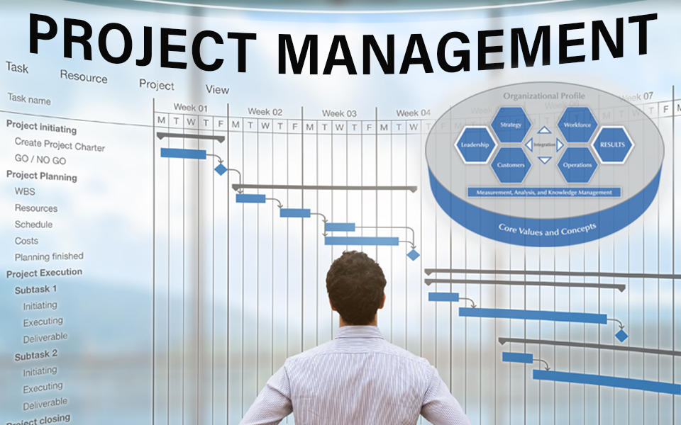
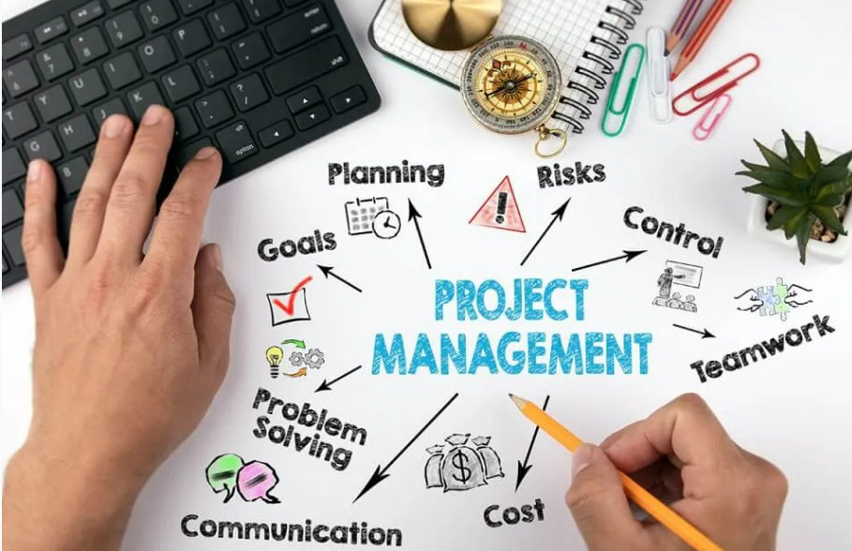
02
PROJECT MANAGEMENT LIFE CYCLE-
Phase 1 − Project Initiation
Phase-2: Project planning
Phase-3: Project execution
Phase-4: Task Monitoring and Control
Phase-5: Project Closure

Slide 10
02
PROJECT MANAGEMENT LIFE CYCLE-
Phase 1 − Project Initiation:
The steps are necessary to begin a new project are defined in the initiation phase.
This phase is mostly made up of two primary activities.
Make a Project Charter and stick to it till completion.
Stakeholders should be identified.

Slide 11
02
PROJECT MANAGEMENT LIFE CYCLE-
Phase 1 − Project Initiation:
In the Project Charter and Stakeholder Register, all project-related information is recorded. The project is formally authorized after the project charter is approved.
Project Charter :
A project charter document describes a project to create a shared understanding of its goals, objectives and resource requirements before the project is scoped out in detail.
The project charter helps project managers explain to participants and stakeholders the scope of a project, project objectives, who will participate in the project, along with other details such as possible risks.
In a large organization, the charter may be a multipage document, but in smaller organizations, it may just be a few paragraphs with bulleted items.

Slide 12
02
PROJECT MANAGEMENT LIFE CYCLE-
Project Charter :
The project manager should create the project charter at the beginning of the project.
What should a project charter include?
Project charter templates often include the following parts of the project:
Project goal. This documents the reasons for undertaking the project in clear, concise language. This should determine the project's scope.
Project participants. This identifies who will be involved in the project and clearly states their roles.
Stakeholders. This identifies project sponsors or other people who will be directly affected by the project and need to know about its progress.
Requirements. This identifies the resources required for the project's objectives to be achieved.
Phase 1 − Project Initiation:

Slide 13
02
PROJECT MANAGEMENT LIFE CYCLE-
Project Charter :
What should a project charter include?
Implementation milestones: This identifies the start and ideal completion dates, as well as dates for other potentially important checkpoints, like a project schedule.
Communication: This specifies how the project manager will communicate with project owners, participants and key stakeholders throughout the project.
Deliverables: This documents what specific products, processes or services the project provides upon completion.
Cost: This identifies a general overview of the project budget.
Phase 1 − Project Initiation:

Slide 14
02
PROJECT MANAGEMENT LIFE CYCLE-
Project Charter :
The project's primary parts are defined in the Project Charter.
Aims of the project
Problem statements and project restrictions
Appoint a project manager.
List of stakeholders
Schedule and budget at a high level
Milestones
Approvals
Phase 1 − Project Initiation:

Slide 15
02
PROJECT MANAGEMENT LIFE CYCLE-
Project Charter :
Stakeholder Identification
A stakeholder may have an impact on the project's success or failure. A Stakeholder Register is used to record information about the stakeholder. The stakeholder registration will include details such as
Stakeholder types
Stakeholder expectations
Project Participation ( Business Analyst, Tech architect, Client PM)
Affirmation (Director, Business Lead, etc.)
Communication frequency (weekly/monthly)
Phase 1 − Project Initiation:

Slide 16
02
PROJECT MANAGEMENT LIFE CYCLE-
Tips to create Project Charter :
To successfully create a project charter, project managers should do the following:
Keep it short: Each section of the charter can be just a few sentences. The project charter should be a high-level overview of a project and not an in-depth breakdown.
Seek team insights: Communicating to the project team members should aid in creating realistic goals and milestones and identifying possible project risks.
Create and use a charter template: A charter template helps keep the charter clear and concise and can be used to create future project charters.
Create an implementation plan: After organizing the charter, project managers should begin planning how to implement it. This includes talking to project members and stakeholders and gathering and collecting funds and resources.
Phase 1 − Project Initiation:

Slide 17
02
PROJECT MANAGEMENT LIFE CYCLE-
Phase 2 − Project Planning:
Incorporates each segment related to the execution of the venture including the expenses, dangers, assets, and timetables
Make Task List
Make a Budget
Make a Project Schedule

Slide 18
02
PROJECT MANAGEMENT LIFE CYCLE-
Phase 3 − Project Execution:
Assignment Management
Time Table Management
Cost Management
Quality Management

Slide 19
02
PROJECT MANAGEMENT LIFE CYCLE-
Phase 4 − Task Monitoring and Control:
The fourth stage is project monitoring and control, which happens simultaneously as the execution period of the venture.
It includes observing the advancement and execution of the undertaking to guarantee sure that it stays on time and inside the spending plan
Quality control systems are applied to ensure quality affirmation.
The greatest issues in an undertaking are commonly identified with time and cost.

Slide 20
02
PROJECT MANAGEMENT LIFE CYCLE-
Phase 5 − Project Closure:
The fifth stage is project conclusion, in which the last expectations are introduced to the customer or partner.
When affirmed, assets are delivered, documentation is finished and everything is approved.

Slide 21
1.3 PROJECT MANAGEMENT PROCESS

Slide 22
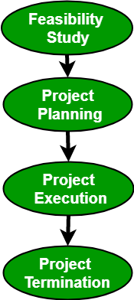
03
PROJECT MANAGEMENT PROCESS-
The Project Management Process consists of the following 4 stages:
Feasibility study
Project Planning
Project Execution
Project Termination
Technical Feasibility –
Operational Feasibility
Economic Feasibility
Legal Feasibility

Slide 23
03
PROJECT MANAGEMENT PROCESS-
Feasibility Study: A feasibility study explores system requirements to determine project feasibility. There are several fields of feasibility study including economic feasibility, operational feasibility, and technical feasibility. The goal is to determine whether the system can be implemented or not. The process of feasibility study takes as input the required details as specified by the user and other domain-specific details. The output of this process simply tells whether the project should be undertaken or not and if yes, what would the constraints be. Additionally, all the risks and their potential effects on the projects are also evaluated before a decision to start the project is taken.

Slide 24
03
PROJECT MANAGEMENT PROCESS-
Project Planning: A detailed plan stating a stepwise strategy to achieve the listed objectives is an integral part of any project. Planning consists of the following activities:
Set objectives or goals
Develop strategies
Develop project policies
Determine courses of action
Making planning decisions
Set procedures and rules for the project
Develop a software project plan
Prepare budget
Conduct risk management
Document software project plans

Slide 25
03
PROJECT MANAGEMENT PROCESS-
Project Execution: A project is executed by choosing an appropriate software development lifecycle model(SDLC). It includes a number of steps including requirements analysis, design, coding, testing and implementation, testing, delivery, and maintenance. There are a number of factors that need to be considered while doing so including the size of the system, the nature of the project, time and budget constraints, domain requirements, etc. An inappropriate SDLC can lead to the failure of the project.

Slide 26
03
PROJECT MANAGEMENT PROCESS-
Project Termination: There can be several reasons for the termination of a project. Though expecting a project to terminate after successful completion is conventional, at times, a project may also terminate without completion. Projects have to be closed down when the requirements are not fulfilled according to given time and cost constraints.
Some of the reasons for failure include:
Fast-changing technology
Project running out of time
Organizational politics
Too much change in customer requirements
Project exceeding budget or funds

Slide 27
03
PROJECT MANAGEMENT PROCESS-
Project Termination
Once the project is terminated, a post-performance analysis is done. Also, a final report is published describing the experiences, lessons learned, and recommendations for handling future projects.
Project management is a systematic approach to planning, organizing, and controlling the resources required to achieve specific project goals and objectives. The project management process involves a set of activities that are performed to plan, execute, and close a project. The project management process can be divided into several phases, each of which has a specific purpose and set of tasks.

Slide 28
03
PROJECT MANAGEMENT PROCESS-
The main phases of the project management process are:
Initiation: This phase involves defining the project, identifying the stakeholders, and establishing the project’s goals and objectives.
Planning: In this phase, the project manager defines the scope of the project, develops a detailed project plan, and identifies the resources required to complete the project.
Execution: This phase involves the actual implementation of the project, including the allocation of resources, the execution of tasks, and the monitoring and control of project progress.
Monitoring and Control: This phase involves tracking the project’s progress, comparing actual results to the project plan, and making changes to the project as necessary.
Closing: This phase involves completing the project, documenting the results, and closing out any open issues.
Effective project management requires a clear understanding of the project management process and the skills necessary to apply it effectively. The project manager must have the ability to plan and execute projects, manage resources, communicate effectively, and handle risks and issues.

Slide 29
03
PROJECT MANAGEMENT PROCESS-
Advantages of the project management process:
Provides a structured approach to managing projects.
Helps to define project objectives and requirements.
Facilitates effective communication and collaboration among team members.
Helps to manage project risks and issues.
Ensures that the project is delivered on time and within budget.
Disadvantages of the project management process:
Can be time-consuming and bureaucratic
May be inflexible and less adaptable to changes
Requires a skilled project manager to implement effectively
May not be suitable for small or simple projects.

Slide 30
1.4 ROLE OF PROJECT MANAGER

Slide 31
04
ROLE OF PROJECT MANAGER-
A software project manager is the most important person inside a team who takes the overall responsibilities to manage the software projects and play an important role in the successful completion of the projects. A project manager has to face many difficult situations to accomplish these works. In fact, the job responsibilities of a project manager range from invisible activities like building up team morale to highly visible customer presentations. Most of the managers take responsibility for writing the project proposal, project cost estimation, scheduling, project staffing, software process tailoring, project monitoring and control, software configuration management, risk management, managerial report writing and presentation and interfacing with clients. The task of a project manager are classified into two major types:
Project planning
Project monitoring and control

Slide 32
04
ROLE OF PROJECT MANAGER-
Project Planning
Project planning is undertaken immediately after the feasibility study phase and before the starting of the requirement analysis and specification phase.
Project planning is completed before any development phase starts.
Project planning is done with most care and attention.
A wrong estimation can result in schedule slippage. Schedule delay can cause customer dissatisfaction, which may lead to a project failure.
For effective project planning, in addition to a very good knowledge of various estimation techniques, past experience is also very important.

Slide 33
04
ROLE OF PROJECT MANAGER-
Project Planning
During the project planning the project manager performs the following activities:
1. Project Estimation: Project Size Estimation is the most important parameter based on which all other estimations like cost, duration and effort are made.
Cost Estimation: Total expenses to develop the software product is estimated.
Time Estimation: The total time required to complete the project.
Effort Estimation: The effort needed to complete the project is estimated.
2. Scheduling: After completion of estimation of all the project parameters, scheduling for manpower and other resources are done
3. Risk Management: The project manager should identify the unanticipated risks that may occur during project development risk, analysis the damage might cause these risks and take risk reduction plan to cope up with these risks.
4. Miscellaneous plans: This includes making several other plans such as quality assurance plan, configuration management plan, etc.

Slide 34
04
ROLE OF PROJECT MANAGER-
Project Monitoring and Control
Project monitoring and control activities are undertaken once the development activities start. The main focus of project monitoring and control activities is to ensure that the software development proceeds as per plan. This includes checking whether the project is going on as per plan or not. If any problem created then the project manager must take necessary action to solve the problem.
Lead the team: The project manager must be a good leader who makes a team of different members of various skills and can complete their individual task.
Motivate the team-member: One of the key roles of a software project manager is to encourage team member to work properly for the successful completion of the project.
Tracking the progress: The project manager should keep an eye on the progress of the project. A project manager must track whether the project is going as per plan or not. If any problem arises, then take necessary action to solve the problem. Moreover, check whether the product is developed by maintaining correct coding standards or not.
Liaison: Project manager is the link between the development team and the customer. Project manager analysis the customer requirements and convey it to the development team and keep telling the progress of the project to the customer. Moreover, the project manager checks whether the project is fulfilling the customer requirements or not.
Documenting project report: The project manager prepares the documentation of the project for future purpose. The reports contain detailed features of the product and various techniques. These reports help to maintain and enhance the quality of the project in the future.

Slide 35
04
ROLE OF PROJECT MANAGER-
Project Monitoring and Control
Necessary skills of software project manager: A good theoretical knowledge of various project management technique is needed to become a successful project manager, but only theoretical knowledge is not enough. Moreover, a project manager must have good decision-making abilities, good communication skills and the ability to control the team members with keeping a good rapport with them and the ability to get the work done by them. Some skills such as tracking and controlling the progress of the project, customer interaction, good knowledge of estimation techniques and previous experience are needed.
Skills that are the most important to become a successful project manager are given below:
Knowledge of project estimation techniques
Good decision-making abilities at the right time
Previous experience of managing a similar type of projects
Good communication skill to meet the customer satisfaction
A project manager must encourage all the team members to successfully develop the product
He must know the various type of risks that may occur and the solution for these problems

Slide 36
04
ROLE OF PROJECT MANAGER-
In Short
Budget forecasting
Budget management
Business strategy development
Defining the scope of work
Document sharing
Gantt chart and timeline development
Progress measurement
Progress reporting
Quality control
Staffing
Strategic oversight
Vendor management

Slide 37
04
ROLE OF PROJECT MANAGER-
Role 1: Team and Timeline Management
The role of a project manager is uniquely positioned with visibility into the multiple functions or task-forces of a team. For example, in launching a mobile application, the project manager may work with:
Web developers
Content developers
Graphic designers
Marketing teams
Social media community managers
And many others!
However, each of these functions may not speak to one another or have full line-of-sight into the project deliverable. As a project manager, it’s your role to manage relationships with each of these teams, report progress to the project owner, and share information across functions.

Slide 38
04
ROLE OF PROJECT MANAGER-
Role 2: Team Organization
An essential role of a project manager is to organize teams to deliver on an outcome. This means understanding the various team functions, structuring them in a way that’s efficient, and communicating program progress and expectations in a timely manner. None of this can be done without being organized.
Look around your personal area. Are there piles of paper or clutter on your desk or counters? Do you have a “to-do” list that seems only to get longer? These are signs of poor organization. And, if you can’t organize your own life, why would someone hire you to organize theirs? By getting organized personally, organizing teams in a project manager role will improve dramatically.
As a project manager, it’s your role to work seamlessly across teams to structure timelines, outline deliverables, and hold vendor or client teams accountable. New software helps make this easier, but it’s imperative that the project manager bring organization to a diverse group to streamline project activities.

Slide 39
04
ROLE OF PROJECT MANAGER-
Role 3: Technology Integration
In this digital age, it’s important as a project manager to leverage existing technology to enhance workstream transparency, share information, synthesize data, and alert internal and external stakeholders to programmatic updates. When it comes to technology, we know that file sharing, time tracking, email integration, and budget management are among the top most used and requested features in project management software. In the project manager role, you must understand these digital platforms, own management of these systems, and synthesize data inputs to make decisions for your team.

Slide 40
04
ROLE OF PROJECT MANAGER-
Role 4: Leadership
Teamwork, conflict resolution, and adaptability are often difficult to teach but are increasing in importance for project managers. Research from the Society for Human Resource Management found that employers care more about soft skills than they do technical abilities like reading comprehension and mathematics. Even more, in the Project Management Institute's 2018 survey, 51% of respondents said that soft skills are more important today than they were just five years ago.

Slide 41
04
ROLE OF PROJECT MANAGER-
Role 5: Performance Tracking and Measurement
No project is considered a success without the proper measurement tools to showcase strategic alignment and return on investment. Project managers are often the individuals working across teams to support the identification of key performance indicators and own the reports shared with business executives to justify program progress.
In the project manager role, it’s important to understand the value of click-through rates, conversion rates, open rates, shares and likes, and more. But as a project manager, you must take the data one step further, interpreting the numbers and reports to share what they may mean. For example, if last month your project’s email open rate was 10%, but two months ago it was only five percent, the report you share with executives should outline what caused the jump – was it new subject line testing? Was video content shared versus static text? These findings are what influence strategy as the project continues, in addition to providing a rationale for programmatic changes that may be needed.

Slide 42
1.5 QUALITY METRICS

Slide 43
05
1.5 QUALITY METRICS-
In project management, quality metrics are used to measure the success of a project in meeting its goals. There are a variety of quality metrics.
Some common quality metrics include customer satisfaction, cycle time, failure rate, quality control, defect density and more. Each metric measures something different, but all are important in ensuring the success of your project

Slide 44
05
1.5 QUALITY METRICS-
What are quality metrics?
Quality metrics are a vital part of project management. By tracking and measuring the quality of your project, you can identify potential problems and risks, and take the necessary actions to reduce risks while it can massively help to avoid costly delays or errors.

Slide 45
05
1.5 QUALITY METRICS-
Schedule Performance Index
Productivity
Customer Satisfaction
Cycle Time
Cost Control
On-Time Performance
Failure Rate
Defect Frequency
Quality Control

Slide 46
05
1.5 QUALITY METRICS-
Schedule Performance Index (SPI) :
The is a project management tool that is used to measure the progress of a project against its schedule. The SPI is calculated by dividing the earned value (EV) of a project by the planned value (PV) of the project. The resulting number is then multiplied by 100 to get a percentage.
The SPI can be used to assess the health of a project and to identify potential problems. A low SPI indicates that a project is falling behind schedule, while a high SPI indicates that a project is ahead of schedule. The SPI can also be used to compare the progress of different projects.

Slide 47
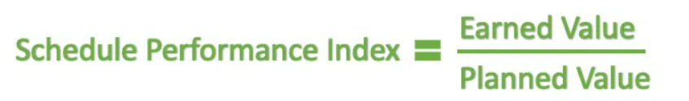
05
1.5 QUALITY METRICS-
Schedule Performance Index
How to calculate the Schedule Performance Index
Calculate the Earned Value (EV)
Earned Value refers to the completed work. It is often referred to as the Budgeted Cost of Work Performed (BCWP). It is calculated using the project’s budget.
EV = Actual percentage of completion * Budget at completion (BAC)
Calculate the Planned Value (PV)
Planned value is the work to be completed in the given time.
PV = Planned Value = (Planned % Complete) X (BAC)
Calculate the Schedule Performance Index (SPI)

Slide 48
05
1.5 QUALITY METRICS-
Calculate Schedule Performance Index Example
SPI Example – Imagine this, you are a project manager whose budget is $40,000 for a new computer program in the Software Development Company you work for. As time goes by, 20% of the work is completed, but it is against your 35% initial plan and you have spent $25,000 already.
Project Budget = $40,000
Earned Value (EV) = 20% of $ 40,000 = $8000
Planned Value (PV) = 35% of $ 40,000 = $14,000
Schedule Performance Index (SPI) = 8000/14000
Therefore, The Schedule Performance Index (SPI) = 0.57
And as 0.57 is less than 1, that means the project is behind schedule.

Slide 49
05
1.5 QUALITY METRICS-
2. Productivity
Productivity is a measure of how efficiently resources are used to produce a desired output. In project management, productivity is often used to measure the progress of a project or to compare the efficiency of different project management methods.
There are a number of different productivity metrics that can be used, but the most common one is output per unit of time. This metric compares the amount of work produced in a given period of time (usually an hour) to the amount of time that was actually worked.

Slide 50
05
1.5 QUALITY METRICS-
3. Customer Satisfaction
Customer satisfaction surveys are a common quality metric used to gauge how well a project is meeting the needs of its users.
It can be used in project management to gauge whether or not a project is meeting the needs of its customers. If its score is low, it may indicate that the project is not meeting customer expectations and needs to be improved. Conversely, a high Customer Satisfaction score can show that the project is successfully meeting customer needs and can be considered a success.
It can be calculated by surveying customers and asking them to rate their level of satisfaction on a scale of 1 to 5 (1 being very unsatisfied, 5 being very satisfied). (Likert Scale Technique)

Slide 51
05
1.5 QUALITY METRICS-
4. Cycle Time :
Cycle time is the metric used in agile project management to measure the amount of time it takes to complete a task. This metric is used to help agile teams optimize their workflow and improve their efficiency.
Cycle time can be used to measure the amount of time it takes to complete a sprint, or it can be used to measure the amount of time it takes to complete a specific task. Also, it is often used to identify areas of improvement in the project management process.

Slide 52
05
1.5 QUALITY METRICS-
5. Cost Control:
The cost control metric is a valuable tool that can be used to monitor and control the costs of a project in order to keep a project on track.
This can be done on a monthly or even weekly basis. By tracking the cost control metric, you can quickly see if the project is on track to stay within its budget.
One example of cost control in project management can be when creating a project budget, monitoring project spending, and using earned value management techniques. By using these and other cost control measures, project managers can help to ensure that their projects stay on track and on budget.

Slide 53
05
1.5 QUALITY METRICS-
6. On-Time Performance:
The On-Time performance metric is a measure of how well a project is delivering its planned outputs on time. This metric is a valuable tool for project managers as it allows them to track the progress of their project and identify any potential risks of delays.
To use the ON-TIME performance metric, project managers should first identify the total number of planned outputs for their project. They should then track the number of outputs that are delivered on time and divide this by the total number of planned outputs. The resulting number will give the project manager an indication of how well their project is performing in terms of on-time delivery.

Slide 54
05
1.5 QUALITY METRICS-
7. Failure Rate:
The failure rate is a metric used to measure the number of failures in a given process or system. It is typically expressed as a percentage or a ratio, and it can be used to track the performance of a process or system over time.
The failure rate can be used in project management to help identify potential problems and mitigate risks. It can also help you to understand the root causes of failures and identify opportunities for improvement.

Slide 55
05
1.5 QUALITY METRICS-
8. Defect Frequency:
The defect frequency metric is a measure of the number of defects per unit of time. It is often used in project management to track the progress of a project and to identify areas where improvements need to be made.
To calculate the defect frequency metric, you first need to identify the total number of defects for a given period of time. This can be done by looking at the project’s bug tracker or by conducting a review of the project’s code. Once you have the total number of defects, you can then calculate the defect frequency by dividing the total number of defects by the total project duration.
For example, if a product has 100 defects, and there are 1,000 units of that product, the defect frequency would be 100/1,000.

Slide 56
05
1.5 QUALITY METRICS-
9. Quality Control:
This is way general in terms of Quality, as there are many different quality control metrics that can be used to measure a project’s quality. Some common metrics include the number of defects, the number of customer complaints, and the cost of quality. Quality control metrics can be used to assess the quality of a project at any stage of development. Project Management includes project charter.

Slide 57
Risk Management Process
Managers can plan their strategy based on four steps of risk management which prevails in an organization. Following are the steps to manage risks effectively in an organization:
Risk Identification
Risk Analysis
Risk Mitigation (the action of reducing the severity)
RMMM (Risk Mitigation, Monitoring, and Management)
Project risks concern various sorts of monetary funds, schedules, personnel, resource, and customer-related issues. a vital project risk is schedule slippage.
Risk = Potential Negative Event + Impact + Probability of Occurrence

Slide 58
Risk Management Process
Risk Identification :
Managers face many difficulties when it comes to identifying and naming the risks that occur when undertaking projects. It's important to understand that risks pertaining to the project can only be handled by the project manager and other stakeholders of the project.
Risks, such as operational or business risks will be handled by the relevant teams. The risks that often impact a project are supplier risk, resource risk and budget risk. Supplier risk would refer to risks that can occur in case the supplier is not meeting the timeline to supply the resources required.
Resource risk occurs when the human resource used in the project is not enough or not skilled enough. Budget risk would refer to risks that can occur if the costs are more than what was budgeted.

Slide 59
Risk Management Process
2. Risk Analysis :
It is the process of prioritizing risks for further analysis of project risk or action by combining and assessing their probability of occurrence and impact. It helps managers to lessen the uncertainty level and concentrate on high priority risks.
The inputs for qualitative Project Risk Analysis and Management includes
Risk management plan
Risk register
Enterprise environmental factors
The goal of risk analysis management is to identify and estimate the value of potential threats and then choose what approaches to apply to respond to identified risks. Risk analysis management consists of three coherent activities: 1) Identify threats, 2) Assess probability of their occurrence, and 3) Estimate their impact on the project in terms of working hours.

Slide 60
Risk Management Process
3. Risk Mitigation (the action of reducing the severity) :
Following are measures and steps to be taken for mitigating risks: Communicate with concerned staff to find probable risks.
Identify and eliminate all those causes and issues that can create risk before the beginning of project work.
Develop policy in an organization that will help to continue the project even though some staff leaves the organization.
Maintain corresponding documents in a timely manner. This documentation should be strictly followed as per standards set by the organization.
Conduct timely reviews in order to speed up work.
For conducting every critical activity during software development, provide additional staff is required.

Slide 61
Risk Management Process
4. RMMM (Risk Mitigation, Monitoring, and Management) :
Risk Mitigation : It is an activity used to avoid problems (Risk Avoidance). Steps for mitigating the risks as follows.
Finding out the risk.
Removing causes that are the reason for risk creation.
Controlling the corresponding documents from time to time.
Conducting timely reviews to speed up the work.
Risk Monitoring :
To check if predicted risks occur or not.
To ensure proper application of risk aversion steps defined for risk.
To collect data for future risk analysis.
To allocate what problems are caused by which risks throughout the project.

Slide 62
Risk Management Process
4. RMMM (Risk Mitigation, Monitoring, and Management) :
Risk Management and planning : It assumes that the mitigation activity failed and the risk is a reality. This task is done by Project manager when risk becomes reality and causes severe problems. If the project manager effectively uses project mitigation to remove risks successfully then it is easier to manage the risks. This shows that the response that will be taken for each risk by a manager. The main objective of the risk management plan is the risk register. This risk register describes and focuses on the predicted threats to a software project.

